Slide 1
Hex Army
WIZARD MONKEYS
2021-11-20

Slide 2




Project Description
“Hex Army” is a digital strategy board game built on a hexagonal grid. The game will be built primarily as a level-based player vs ai game.
The game consists of a player controlling units and attempting to destroy enemy units or achieve level-specific objectives.
The game is being written in JavaScript using the Phaser3 engine and a general NodeJS production environment. (CapacitorJS will be used for mobile porting)
The final project will be available to play on mobile devices, either in browser or as an app.

Slide 3
Group Role
Member Responsibilities | Member
Create the hex map | Jeremy Glebe
Create the character of player and enemy | Jeremy Glebe
Create moving animation of player and enemy | Jeremy Glebe
Create the attack and health bar | Jeremy Glebe/Haiyi wang
Add sound, music | Haiyi wang
Function Tesing | Jeremy Glebe/Haiyi wang
Design of frontpage | Haiyi wang
Dcouments | Haiyi wang

Slide 4
Core requirements
the hex map
the characters of player and enemies
the animation of characters moving
the health bar of player and enemy
the player attack with enemy
the change of health bar of enemy are attacked
the background sounds

Slide 5
Implementation details
Language:
JavaScript, CSS, Html
Platform:
Webpack for building the project
Phaser3 for our game engine (mobile supported)
Capacitor to build for mobile/desktop/whatever

Slide 6
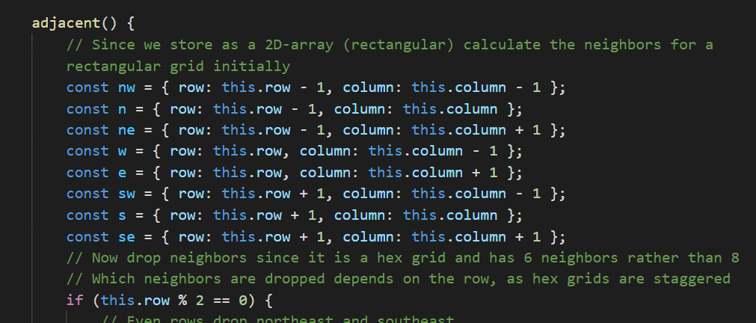
Code inspection results
When our pair member do code inspection of our code, they suggested that we should declare variable name clearly, such as nw=northwest, this could make sense.
We declare the variable name:
nw = northwest, n = north, ne = northeast, w = west, e = east, sw = southwest , s = south ,se = southeast.

Slide 7
Limitations
The enemy moving is not so smart
The enemy moving is control by computer, it just move up, down, left, right, or static.
Limitation
They can’t move smart. We considered that enemy moving should connect with player, they should find the shortest path with player in the map. But considering the algorithms of finding shortest path and request of the huge amount of calculation in real time. We gave up this thought.

Slide 8

Project demo

Slide 9

Project demo

Slide 10
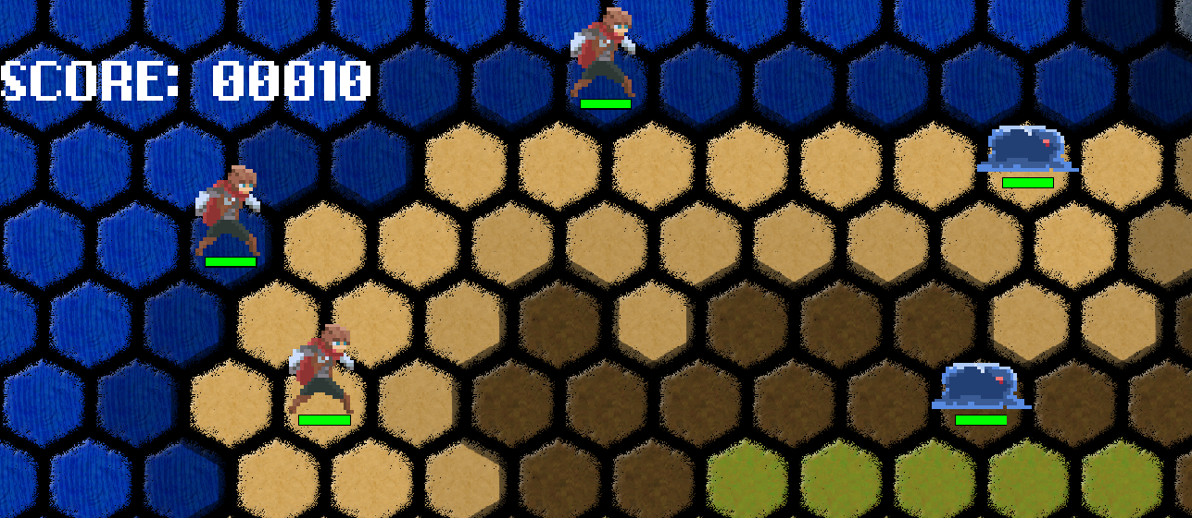
Project demo

Slide 11
Thank you

